Slide 1
Blacktown Chinese Christian Church
Welcome to Our English Service 05.10.2025
English Service 9:45 – 11:00 am
Worship Songs: Passage: Speaker: Topic: Response Song: Announcements and Closing Prayer Benediction
Hosanna 1 Peter 2:1-10 Combined Service (Xavier) God's Newborn Babies TBA

Slide 2
BCCC english service

Slide 3

Please keep all phones on silent

Slide 4
Hosanna
Hosanna
Brooke Ligertwood ©2006 Hillsong Music Publishing Australia CCLI Licence No. 5485849. CCLI Song number: 4785835
布鲁克·利格伍德
©2006 Hillsong Music Publishing Australia
CCLI许可证号5485849。CCLI歌曲编号：4785835

Slide 5
I see the King of glory
我见荣耀君王

Slide 6
Coming on the clouds with fire
驾云携火而来

Slide 7
The whole earth shakes
全地震动

Slide 8
The whole earth shakes yeah
全地震动啊

Slide 9
I see His love and mercy
我见祂爱与怜悯

Slide 10
Washing over all our sin
洗净我众罪污

Slide 11
The people sing
众人歌唱

Slide 12
The people sing
众人歌唱

Slide 13
Hosanna hosanna
和撒那和撒那

Slide 14
Hosanna in the highest
至高处和撒那

Slide 15
Hosanna hosanna
和撒那和撒那

Slide 16
Hosanna in the highest
至高处和撒那

Slide 17
I see a generation
我见一代兴起

Slide 18
Rising up to take their place
站立承接位分

Slide 19
With selfless faith
无私的信

Slide 20
With selfless faith
无私的信

Slide 21
I see a near revival
我见复兴将到

Slide 22
Stirring as we pray and seek
在我们祷告寻求

Slide 23
We're on our knees
我们跪下

Slide 24
We're on our knees
我们跪下

Slide 25
Hosanna hosanna
和撒那和撒那

Slide 26
Hosanna in the highest
至高处和撒那

Slide 27
Hosanna hosanna
和撒那和撒那

Slide 28
Hosanna in the highest
至高处和撒那

Slide 29
Heal my heart and make it clean
医治我心使它洁净

Slide 30
Open up my eyes to the things unseen
开我双眼看见那未见

Slide 31
Show me how to love like You have loved me
教我爱像祢爱我一样

Slide 32
Break my heart for what breaks Yours
为祢伤痛愿我心碎

Slide 33
Everything I am for Your Kingdom's cause
我全部生命都为祢国度

Slide 34
As I walk from earth into eternity
当我离开世界到永恒

Slide 35
Hosanna hosanna
和撒那和撒那

Slide 36
Hosanna in the highest
至高处和撒那

Slide 37
Hosanna hosanna
和撒那和撒那

Slide 38
Hosanna in the highest
至高处和撒那

Slide 39
Hosanna in the highest
至高处和撒那

Slide 40
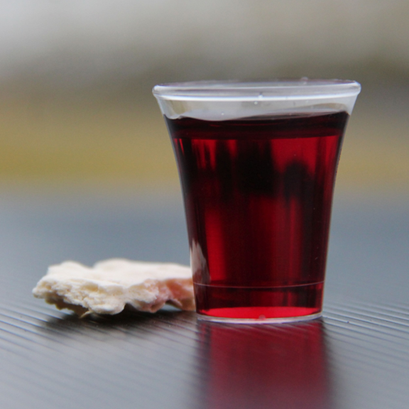
Holy Communion

Slide 41

Bible reading

Slide 42
1 Peter 2:1-10
Therefore, rid yourselves of all malice and all deceit, hypocrisy, envy, and slander of every kind. ² Like newborn babies, crave pure spiritual milk, so that by it you may grow up in your salvation,

Slide 43
1 Peter 2:1-10
³ now that you have tasted that the Lord is good.
⁴ As you come to him, the living Stone—rejected by humans but chosen by God and precious to him—

Slide 44
1 Peter 2:1-10
⁵ you also, like living stones, are being built into a spiritual house to be a holy priesthood, offering spiritual sacrifices acceptable to God through Jesus Christ. ⁶ For in Scripture it says:
“See, I lay a stone in Zion,
a chosen and precious cornerstone,
and the one who trusts in him
will never be put to shame.”

Slide 45
1 Peter 2:1-10
⁷ Now to you who believe, this stone is precious. But to those who do not believe,
“The stone the builders rejected
has become the cornerstone,”
⁸ and,
“A stone that causes people to stumble
and a rock that makes them fall.”
They stumble because they disobey the message—which is also what they were destined for.

Slide 46
1 Peter 2:1-10
⁹ But you are a chosen people, a royal priesthood, a holy nation, God’s special possession, that you may declare the praises of him who called you out of darkness into his wonderful light. ¹⁰ Once you were not a people, but now you are the people of God; once you had not received mercy, but now you have received mercy.

Slide 47
Announcements

Slide 48





Account name: Blacktown Chinese Christian Church
Account number: 4216 50263
Offering
BSB: 112 - 879
Please put in "offering" as the reference
The offering box is available at the back of the hall

Slide 49
Prayer points

Slide 50
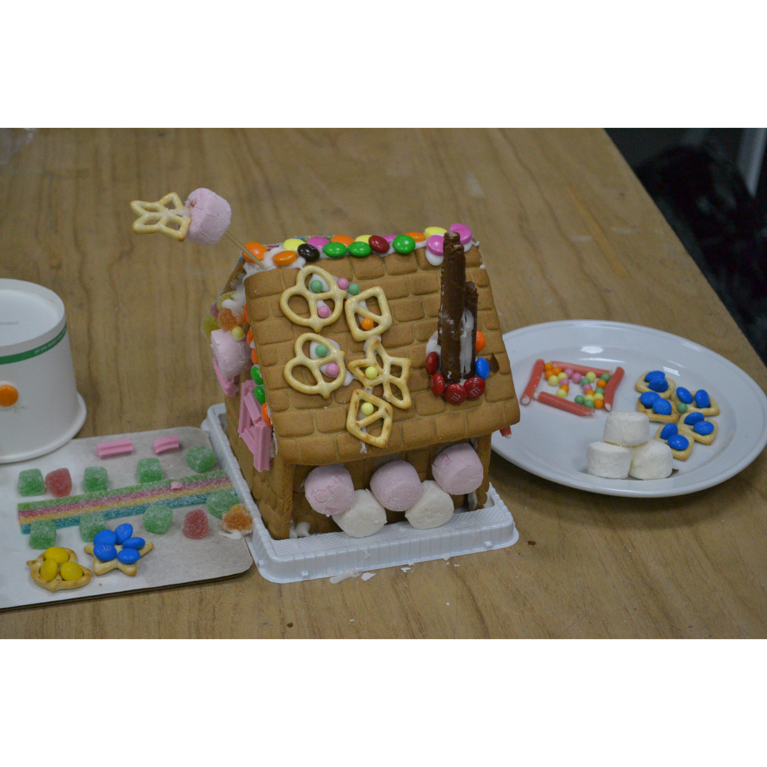
Mingle time!

